Slide 1

HUM111 Pakistan Studies
Lecture 27

Slide 2
HUM 111 Pakistan Studies
Geo-strategic Importance of Pakistan (A)
Dr. Sohail Ahmad

Slide 3
Geo-strategic Importance of Pakistan
Introduction
Pakistan geographical location
Strategic significance:
Proximity of great powers
Gateway to central Asia- oil and energy game
Significance as a transit economy
Significance as an important link in the chain of Muslim countries
Only Muslim country having nuclear capability

Slide 4
Introduction
Pakistan is situated in a region which has great political, economic and strategic location.
It has been the hub of activities of great powers for the past few decades.
It has witnessed intervention of three great powers i-e Britain, USSR, and USA.
Its significance was further enhanced during Cold War when it became ally of the US policy of containment of USSR
The post cold war era has witnessed its significance particularly after 9/11.

Slide 5
Geographical Location of Pakistan
Location: Southern Asia lies between 24 and 36.75 northern latitude and between 61 and 7505 eastern longitude. Area: 7, 96000 sq.km.
Towards north, China is located. Pakistan shares 400 km long boarder with China.
A narrow strip of Afghanistan knows as Wakhan separates Tajikistan from Pakistan.
Towards the East, its shares a border of 1650 km with India.
Afghanistan is situated in the West of Pakistan the two neighbors are separated by Durand line (2250 km).
The Arabian sea is situated in the South of Pakistan. 700 km coastline.
Pakistan significance is enhanced as it lies near the Persian Gulf where 65% of the world's oil is produced.

Slide 6
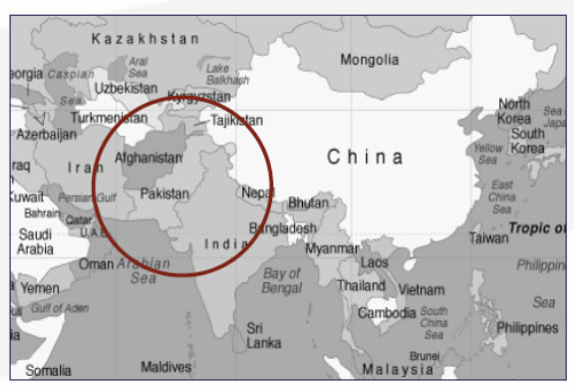
Geographical Location of Pakistan

